Slide 1
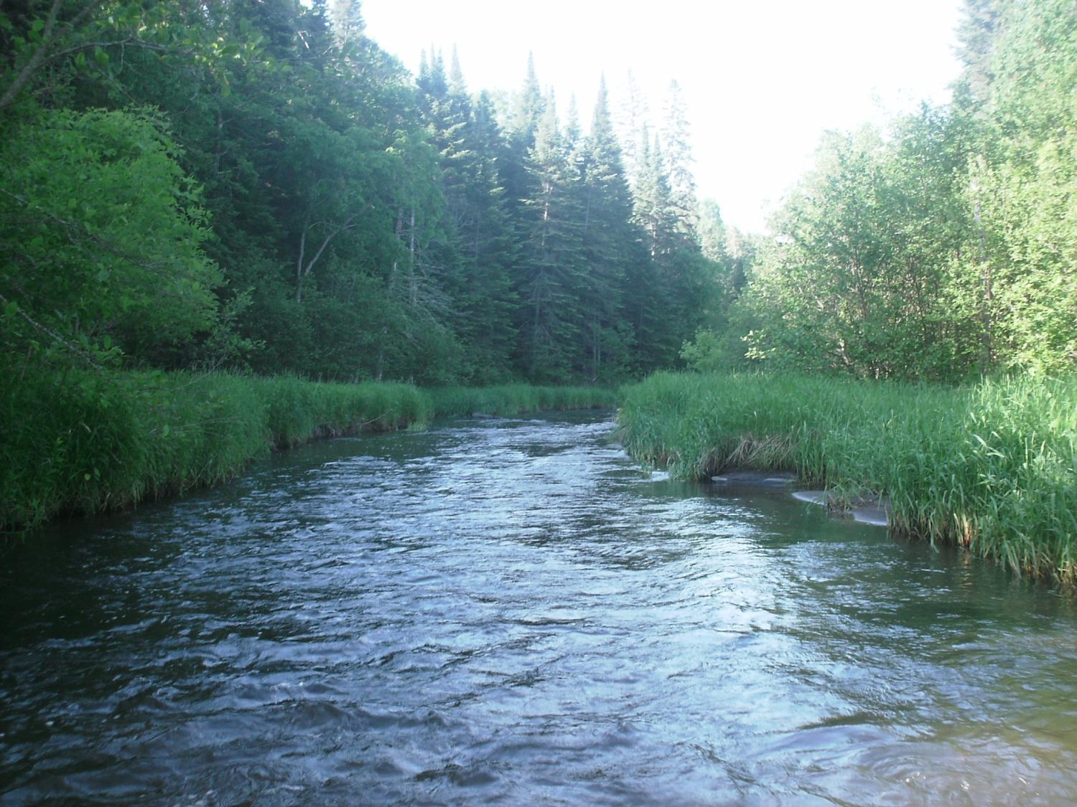
Legislative Water Commission
2019 Recommendation Feedback
Wastewater and Storm Water
Co-chairs: Senator Wiger Representative Torkelson
Jim Stark, Director
Straight River, Becker County
1

Slide 2
Introductions
Kristen Van Amber
Kasey Gerkovich-LCC
Jim Stark- Director
2

Slide 3
Legislative Water Commission
REVIEW-state agencies’ water policy reports & recommendations
GATHER- data and comments
LEGISLATIVE RECOMMENDATIONS: Assist legislature in formulating legislation
SHARE-data & information with LCCMR, CWC, legislative standing committees, upon request
COORDINATE-with the CWC

Slide 4
How can the recommendations be used?
Propose/promote/support legislation
Resource for stakeholders regarding legislative initiatives
Recommendations to guide or suggests programs/planning/funding:
LCCMR
CWC
Agencies

Slide 5
LWC: 12 Members
Body | First Name | Last Name | Party | District | Home
Sen | Paul | Anderson | R | 44 | Plymouth
Rep | David | Bly | DFL | 20B | Northfield
Sen | Rich | Draheim | R |  | Madison Lake
Sen | Kent | Eken | DFL | 4 | Twin Valley
Rep | Peter | Fischer | DFL | 43A | Maplewood
Rep | Glenn | Gruenhagen | R | 18B | Glencoe
Sen | Jason | Isaacson | DFL | 19A | Shoreview
Rep | Clark | Johnson | DFL | 19A | N. Mankato
Rep | John | Poston | R | 9A | Lake Shore
Rep | Paul | Torkelson* | R | 16B | Hanska
Sen | Bill | Weber | R | 22 | Luverne
Sen | Chuck | Wiger* | DFL | 43 | Maplewood

Slide 6
Agenda
2018 Process
2019 Process
Overview of possible 2019 Issues
Describe Today’s Issue
Small Group Review/Report
Next Steps

Slide 7
2019 Recommendations
Six Issues with recommendations:
Based on:
2018 session process
LWC guidance
Stakeholder advice
Review of many plans/documents

Slide 8
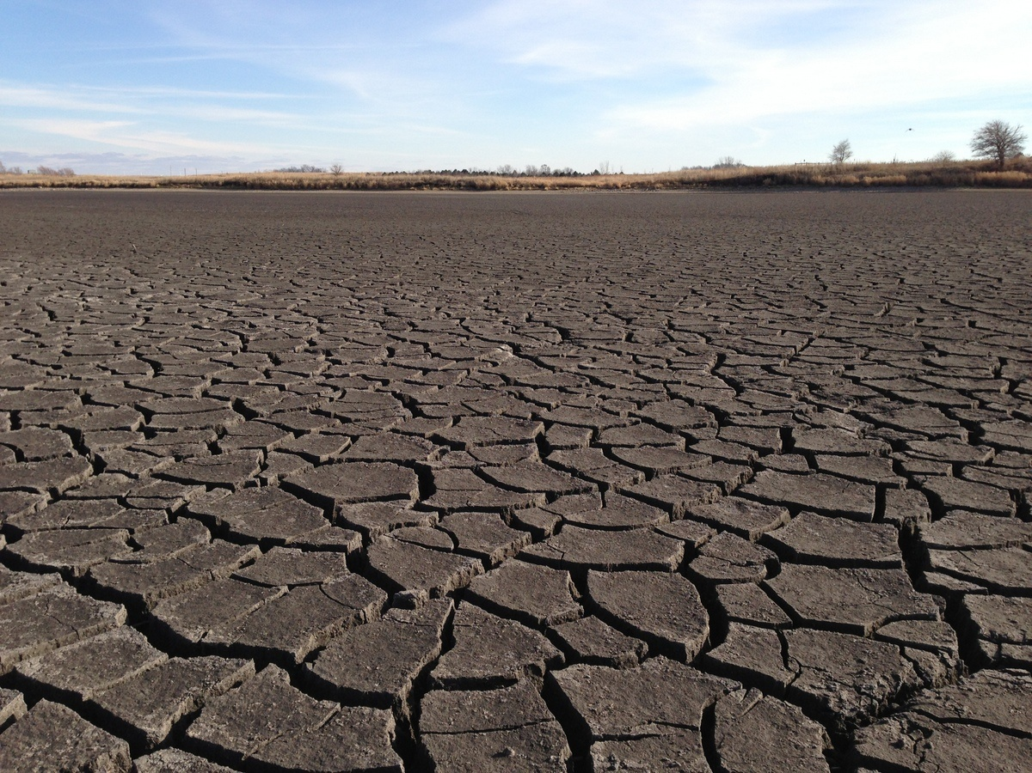
A Firm Foundation
1989- GW Act
1999- USGS Sustainability Report
2004- G16 Impaired Waters Plan (MPCA)
2005- DNR/GW Report
2006- Clean Water Legacy Act
2006- ENRTF Sustainability Report
2008- Clean Water Amendment
2008 Legislative Water Sustainability Framework
2009- EQB Sustainability Report
2012- GW Management Area Plans (DNR)
2017- Freshwater Society Reports on Water Sustainability
(Worthington, MN-2012)

Slide 9
Six Issue Areas
9

Slide 10
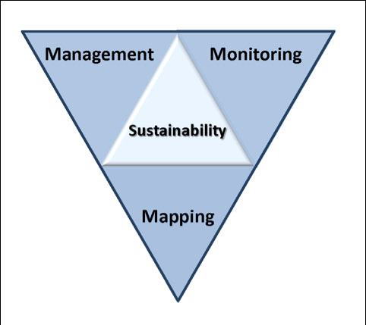
2019 LWC Issues and Recommendations
Wastewater*
Drinking water*
Groundwater
Sustainable Lakes
Water retention
Future state
* Short term
Notes:
Protection of ground water and surface water resources will require substantial investments from a diversity of funding sources over all levels of government during the next decade. As a part of this effort, this program of mapping, monitoring and managing is necessary to deliver the basic understanding of the hydrologic system for both surface and groundwater.

Slide 11
Today’s Issue
11

Slide 12
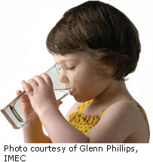
Wastewater/Storm Water
Needs are great:
Significant infrastructure needs– small cities and towns
Infrastructure is aging
Financial resources inadequate
Infiltration and Inflow
Changing water-quality standards
Barr Engineering-- $300 M/Y problem
MPCA Analysis (2018)
$5B need-- 20 years
1050 projects
5% of the need- water quality regulations
Challenges: ages of infrastructure, cost
Notes:
What we hope to leave you with is a much better understanding of our state’s groundwater resources and appreciation for the challenges we face.
Simply stated the problem we are increasingly recognizing is that there are ….

Slide 13
2018: Wastewater/Storm Water
Management/ regulation/ policy
Support infrastructure needs
Nine recommendations
Four moved forward
Some legislative success
Issue carried over to 2019
13

Slide 14
Recommendations: Wastewater
Independent cost-effectiveness reviews of BMPs at WWTPs
“Alternatives” reviews for WWTP operations
Independent peer reviews of wastewater standards
Pilot a watershed-scale nutrient trading program
Identify efficiencies for regional wastewater admin, operations and maintenance– collaboration
Change flushable wipe labels
Continue to support PFA bonding request
Provide inflow/ infiltration funding for sewers
Streamline regulatory process

Slide 15
Today’s Request:
Small groups
Review issues/recommendations
Missing issues?
Missing stakeholders?
Rank issues (H-M-L)
Seeking your input--not consensus
Will revisit issues later
15

Slide 16
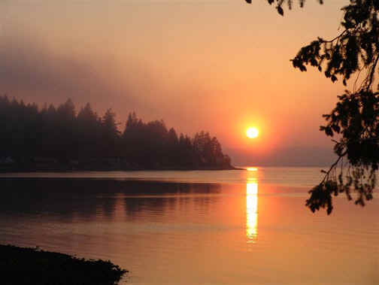
Resources:
Recommendation/issue summary paper-draft
Background issue paper- draft
Notes:
For more information and real time monitoring data you can visit this web site.

Slide 17
Today’s Issue
17

Slide 18
Groundwater Sustainability--Will We Run Out?
Issues:
Warning signs: WB Lake, Areas of Concern, GWMAs
Hidden problem: noted first in lakes, streams, and
wetlands
Issues are well documented
Notes:
For more information and real time monitoring data you can visit this web site.

Slide 19
Recommendations: GW Sustainability
Identify/protect vulnerable aquifers
Balance our water bank accounts
Enhance water appropriation permit process
Increase GW modeling and GWMA process
Costs/benefits of sustainability effort
Study/allow re-use/recharge
Promote inter-jurisdictional water management
Assess GW/SW/Bio interrelation
Reconcile GW/SW interaction in appropriation rules
Dedicate some CWFs for sustainable water programs
Establish a CWC sustainability committee
Legislation: Liability protection for salt applicators
Implement GW Protection Act– nitrate
Identity and protect vulnerable DW aquifers to DW

Slide 20
Small Group Exercise
Discuss recommendations
What’s missing?
Who’s missing?
Rank (H,M,L)
Are they actionable- Move the needle?
Appropriate for Legislation/ Funding/Agency or Stakeholder Resource?
Consensus
Report back:
Top issues (1-2) and missing issue
40 minutes
Notes:
For more information and real time monitoring data you can visit this web site.

Slide 21
Next Steps
Complete Issue papers
Revise recommendations based on your input
Feedback from LWC Members
Additional Feedback from Stakeholders
Final consensus by LWC
Recommendations to Legislature- before session
Legislative Briefings with Committees

Slide 22
Small Group Exercise
Discuss recommendations
What’s missing?
Who’s missing?
Rank (H,M,L)
Are they actionable- Move the needle?
Appropriate for Legislation/ Funding/Agency or Stakeholder Resource?
Report back:
Top issue and most important missing issue
40 minutes
Notes:
For more information and real time monitoring data you can visit this web site.

Slide 23
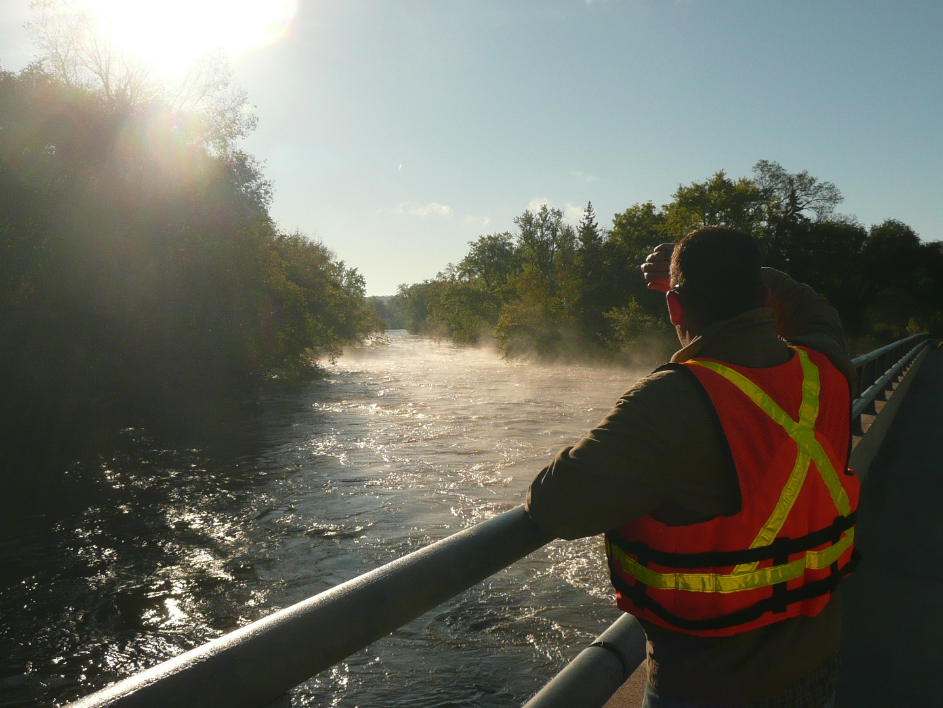
Thank You

Slide 24
Next Steps
Please turn in your spreadsheet (1 per group)
Revise Issue Statements
Revise Recommendations
Initial Consensus from LWC
Feedback from Stakeholders
Final consensus by LWC -November
Recommendations to Legislature
Legislative Briefings with Committee

Slide 25
Thanks!
Notes:
For more information and real time monitoring data you can visit this web site.

